Slide 1
Capstone Final Report: Predicting US Olympic Medals
Aliaksandra Hrytsenka

Slide 2
Introduction
This project aims to predict the number of Olympic medals the United States will win in future Summer and Winter Olympic Games using a combination of economic, geographic, and social indicators from other countries, along with historical Olympic data.

Slide 3
Data Collection and Preparation
Sources of data
Data cleaning and preprocessing steps
The datasets for Winter and Summer Olympics were loaded and inspected for initial exploration.
Missing values and inconsistencies were identified and handled appropriately.

Slide 4
Exploratory Data Analysis
Conducted descriptive statistics to understand the distribution and key characteristics of the data.
Created visualizations to identify patterns and correlations.

Slide 5
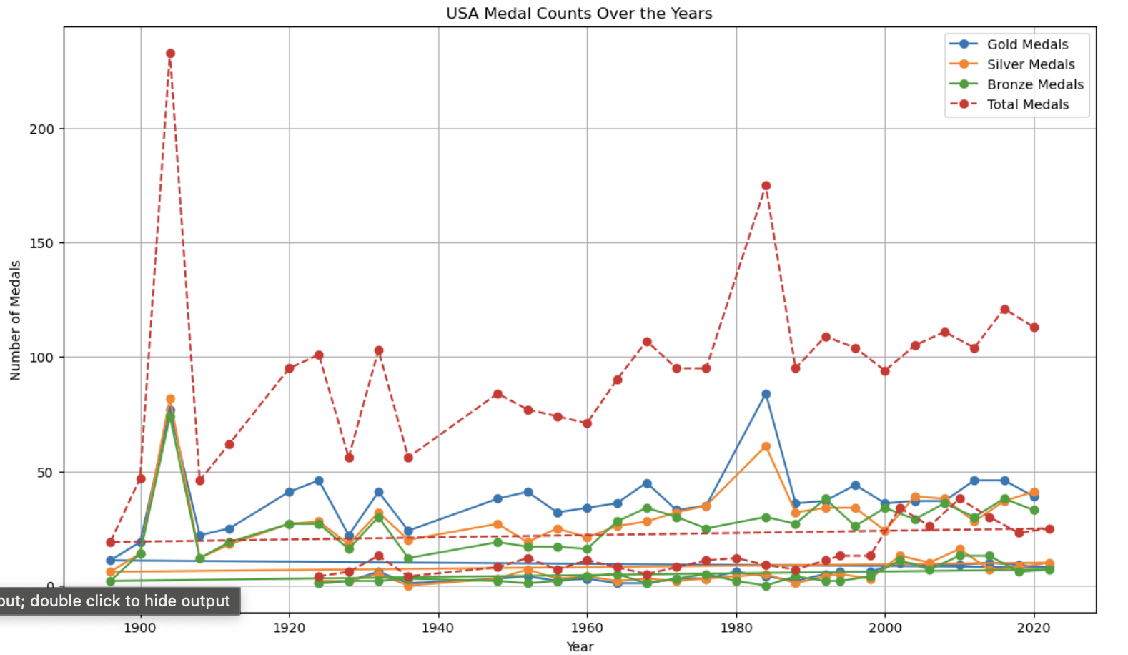
Distribution of Medals
Distribution of Medals visualization

Slide 6
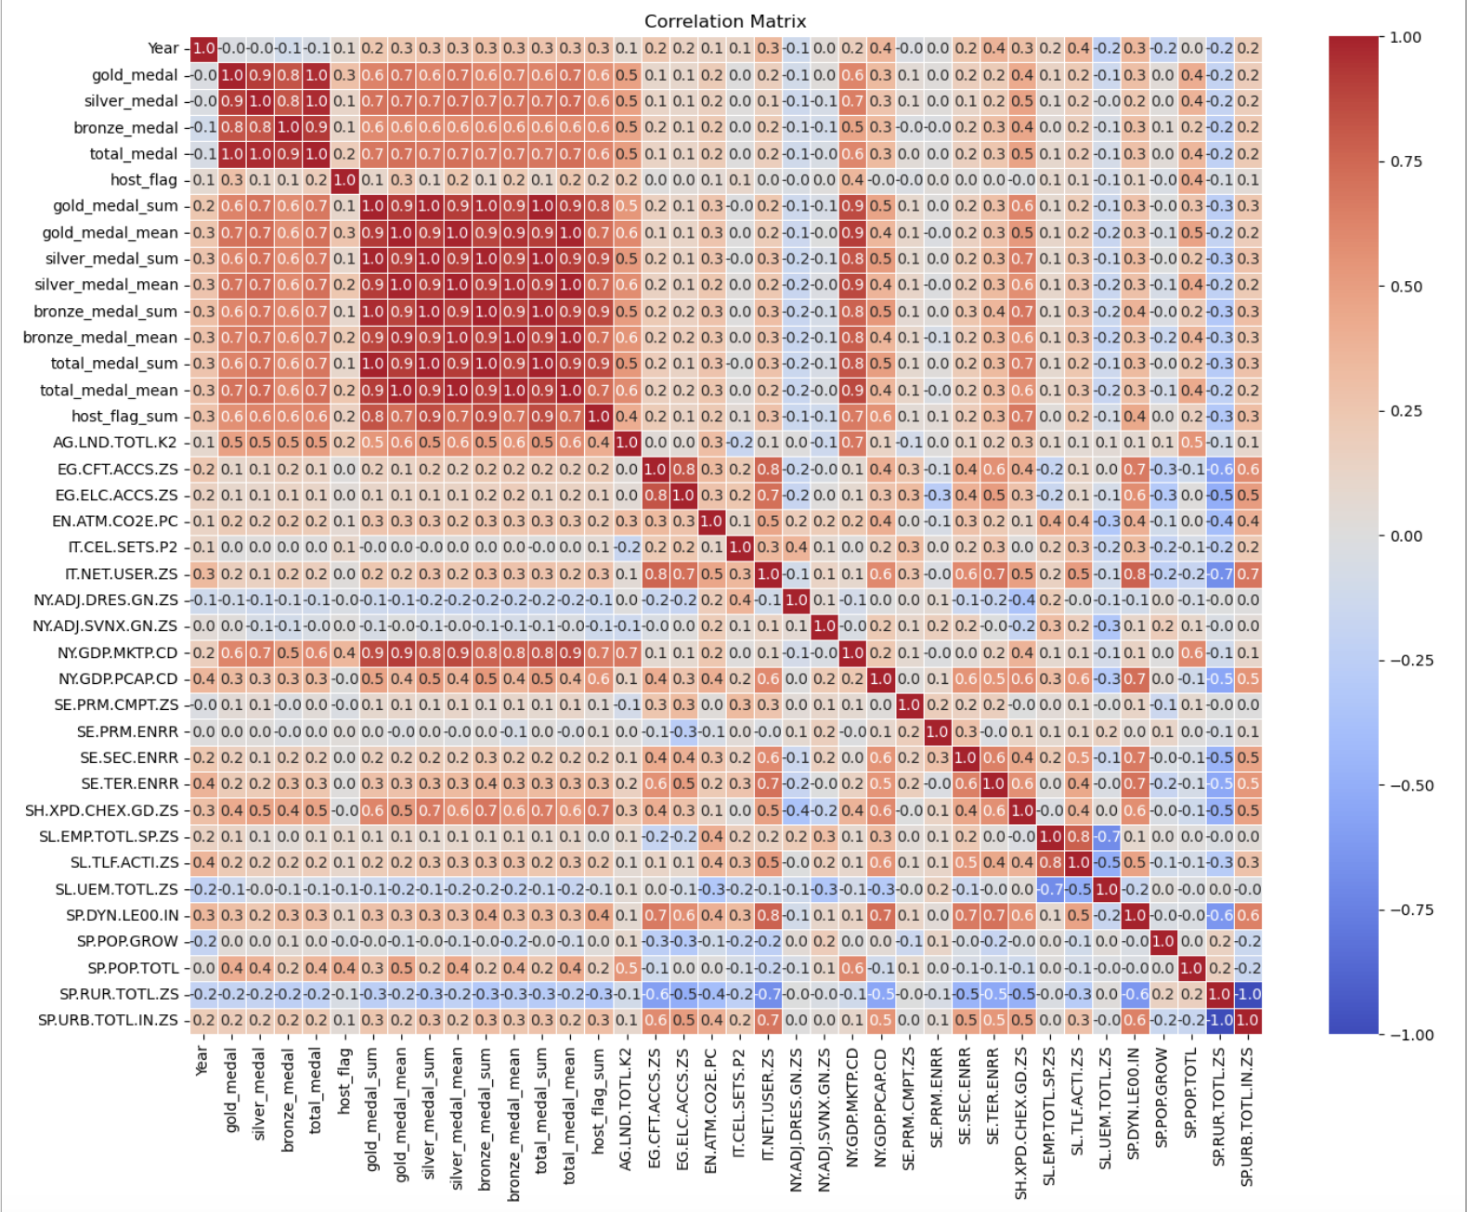
Correlation Heatmap
Correlation Heatmap visualization

Slide 7
Modeling
Model selection : XGBoost
Training and evaluation
Trained multiple models including Gradient Boosting Regressor, Random Forest Regressor, and Stacking Regressor.
Used GridSearchCV and RandomizedSearchCV for hyperparameter optimization.
Evaluated models using MAE and R-squared metrics.

Slide 8
Model Performance
Predicted vs Actual Medals
Winter olympic games predictions = 22.234600067138672
Summer olympic games predictions = 88.13481140136719
Winter olympic games actual = 25.0
Summer olympic games actual = 113.0

Slide 9
Findings and Recommendations
1. Enhance Funding for Athlete Programs
2. Focus on Key Sports
3. Leverage Host Country Advantage

Slide 10
Conclusion
This report outlines a comprehensive approach to predicting US Olympic medal counts using a range of indicators.
By leveraging historical data and modern machine learning techniques, we can provide actionable insights to improve future Olympic performance.

